Slide 1

Predicting the new successful game
Data-Science project
Roi Mualem Hadar Alfasi

Slide 2

Research Question
Can we predict the global sales number of a new released game based on the genre, scores and sales around the world?

Slide 3
Project phases
Machine Learning and Model evaluation
Data Cleaning
1
2
3
4
5
Data gathering and Crawling
EDA
Predictions and Results

Slide 4

1
Data gathering and Crawling

Slide 5
1
Data gathering and Crawling
Sources we used for our project:
https://www.vgchartz.com/
https://www.metacritic.com/game
Crawling - Vgchartz & Metacritic Scrappers
We used BeautifulSoup to gather data from 2 different websites - Vgchartz and Metacritic.
In both of them the users can search for games in any platform, rate, review and score games.
Metacritic website consists information of users and critics scores.
Vgchartz website holds the amount of sales worldwide of all those games.
Merging them together give us the data we used for our project.

Slide 6
1
Data gathering and Crawling
Crawling Strategy:
We started with Vgchartz and dismantled the URL to 3 different parts : head , mid and tail. Then we extracted the data from the first 50 pages of all the games and adding them into our new dataframe.
The information we extracted from Vgchartz of each game :
name, platform, genre, sales, publisher, developer and release date.
Then we used our made Vgchartz data to gather more data for the exact same games by each game’s Name and Platform : the scoring of the users and critics in the Metacritic website.
Lastly we merged both of the dataframes into one big dataframe that holds all the information needed.

Slide 7
2
Data
Cleaning

Slide 8
2
Data Cleaning
Cleaning Strategy:
After Crawling we had some features (ie ‘Global Sales’ column) with null/NAN values so we had to delete those rows from our dataset because they were lacking the data we needed.
Deleted irrelevant rows of data such as :
Games genre rows that had no more than 10 rows of data each.
Release date rows with no value.
Replaced the values of ‘N/A’ and ‘TBD’ in our dataset to ‘None’
Replaced in all sales columns the value ‘null’ to ‘0’
Changed ‘date of release’ column to year numbers.
Organized structure of dataset and column names.

Slide 9
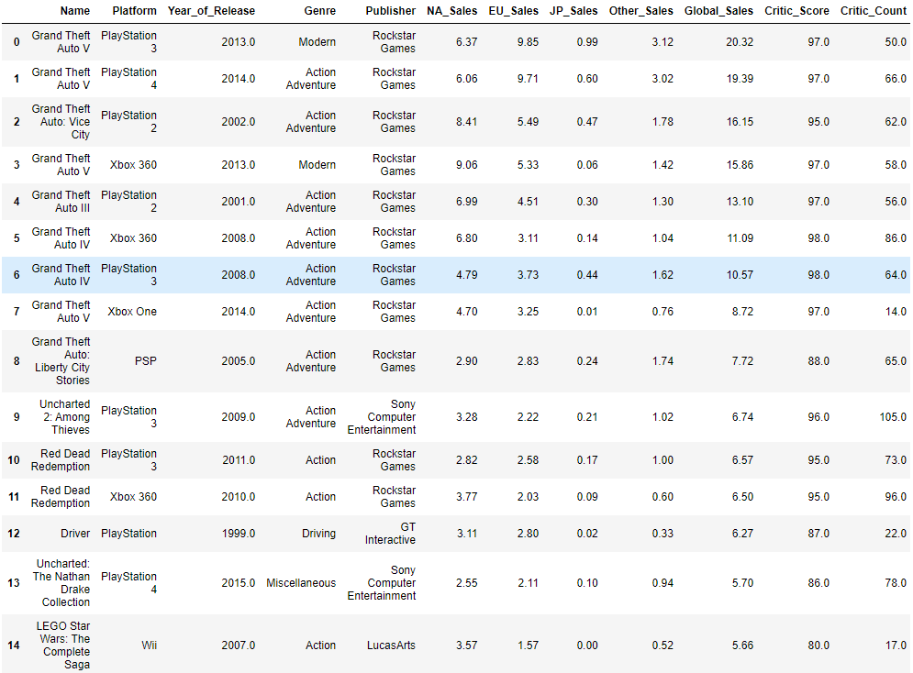
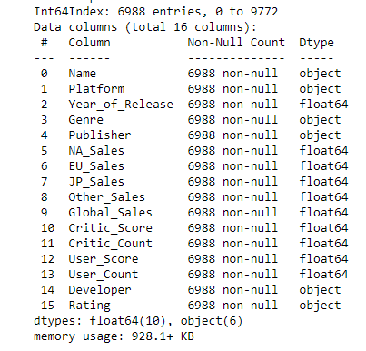
2
Data Cleaning
Cleaned Data:

Slide 10
3
EDA

Slide 11
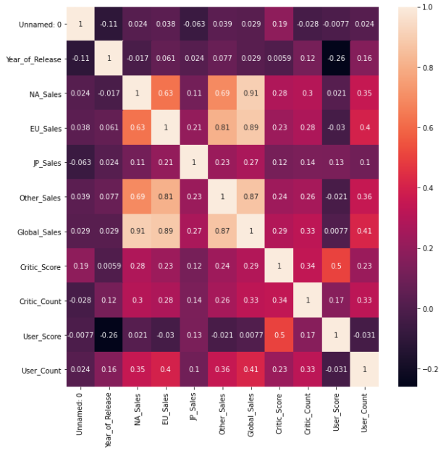
3
EDA
Correlation:

Slide 12
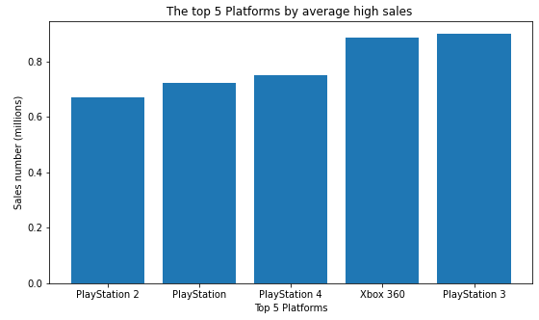
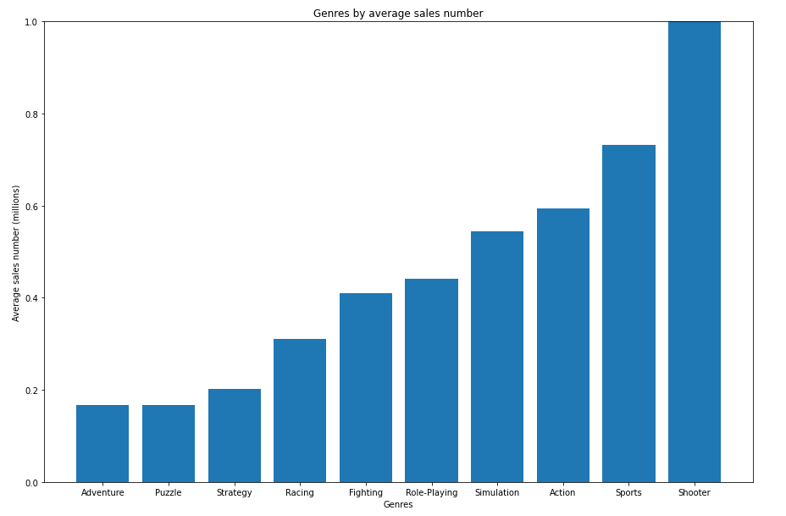
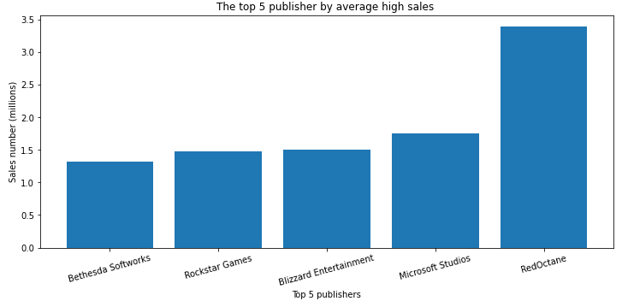
3
EDA

Slide 13
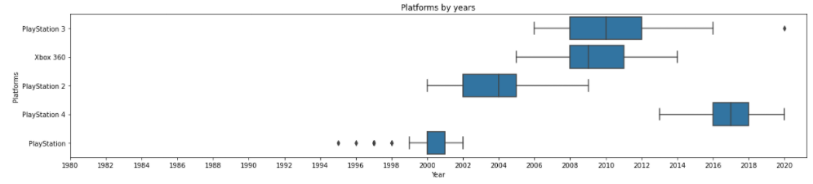
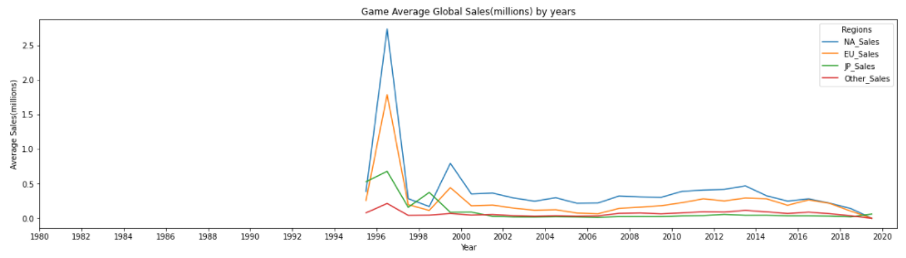
3
EDA

Slide 14
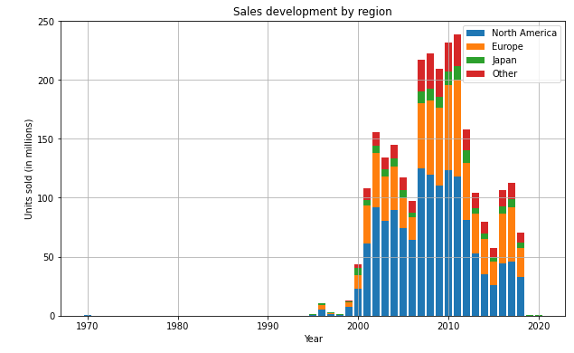
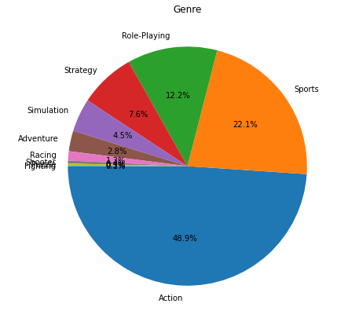
3
EDA

Slide 15
4
Machine Learning and model evaluation

Slide 16
4
ML and model evaluation
Preparation for ML Model:
First we had to prepare the dataset for the machine learning model so we used 2 imputers :
Simple imputer - used to swap null values in all the user and critic scores and counts columns to the ‘mean’ number in each column.
Categorical imputer - used to swap null values in specific columns to ‘NA’ value.
We decided to use 2 Models in our project : XGBRegressor & LinearRegression
XGBRegressor is used because we read online that it is a good algorithm for our specific research. XGBRegressor is a machine learning algorithm based on decision trees similar to the RandomForest algorithm. However, unlike RandomForest that makes use of fully grown trees, XGBoost combines trees that are not too deep. Also, the number of trees combined in XGBoost is more in comparison to RandomForest.
XGBRegressor

Slide 17
4
ML and model evaluation
Preparation for ML Model:
Like the first model we had to prepare the data for the machine learning algorithm by adding a median, an average and the most common value to replace the null values in our data.
We picked sales columns and removed them from the data to keep only one for our machine learning algorithm.
LinearRegression
LinearRegression is based on supervised learning - an ‘X’ database and prediction in continuous ‘Y’ (Global Sales).

Slide 18
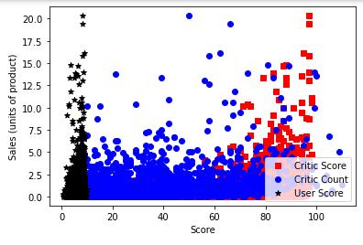
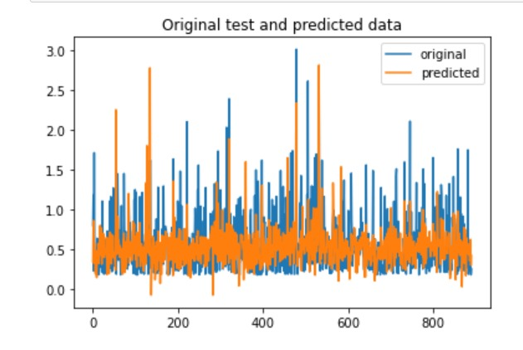
4
ML and model evaluation

Slide 19
5
Predictions and Results

Slide 20
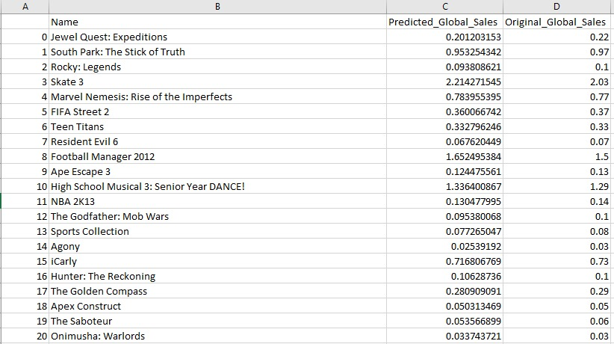
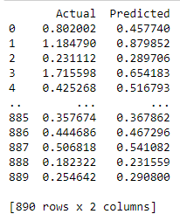
5
Predcitions and Results
XGBRegressor:
LinearRegression:

Slide 21
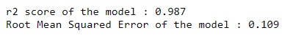
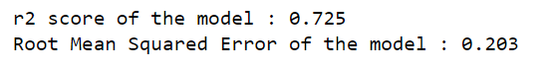
5
Predcitions and Results
Results of the XGBRegressor Model:
Results of the LinearRegression Model:

Slide 22
Thanks
for
listening

